Slide 1

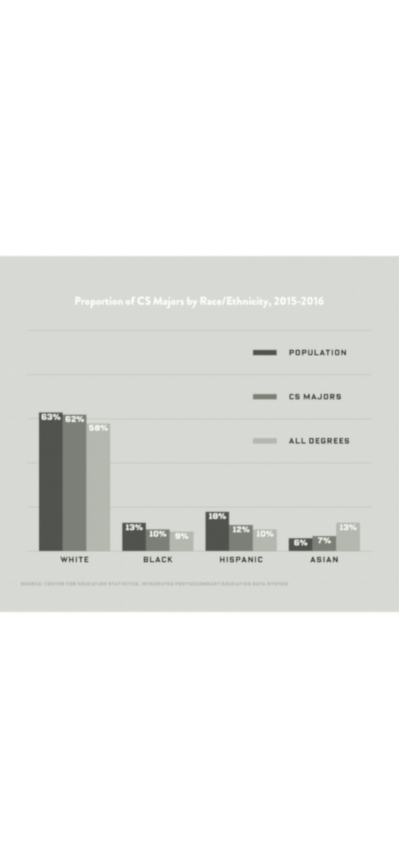

DIVERSITY
IN COMPUTER SCIENCE
01
Introduction
• Diversity in computer science is essential.
• Womenonly hold 26% of computing jobs; Black and Hispanic workers hold 9% and 7%, respectively.
• A more inclusive industry fosters innovation and represents society better.
02
Background
Women’s representation in CS dropped from 37% in 1984 to 24% in 2020.
Stereotypes and limited access discourage underrepresented groups.
Financial barriers also prevent diverse participation.
03
New Ideas
Coding Bootcamps: Early tech exposure in underserved schools.
Scholarships and Mentorship: Supports underrepresented students.
Internships: Gives practical experience to build careers.
Curriculum Updates: Adds contributions from diverse innovators.
04
Benefits
Increased Innovation: Diverse teams bring fresh perspectives.
Meet Workforce Demand: Tech industry faces a growing talent gap.
Reduce Barriers: Inclusive education leads to social mobility.
05
References
Ehrlinger, J., et al. (2018). Gender gaps in computer science.
McHugh, M. (2020). Diversity in CS graduates. WIRED.
Code.org. (2021). Expanding CS education access.

